Slide 1


MTECH PROJECT
MASTERCARD PERSONAL EXPENSE MANAGEMENT SYSTEM – (MPEMS)
PHASE 1 PRESENTATION - TEAM S2

Slide 2

Presentation Overview
Project Background & Team Introduction
User Requirements Overview
Project Risks
Technical Challenges
Overall Project Strategies
Project Timeline and Estimates
Project Progress
Management Problems

Slide 3
Project Background
Project Customer
  MasterCard Singapore
Motivation
  Growing number of credit/debit card users and smartphone user
  Spenders getting more sophisticated
  Absence of consolidated view of all transactions
  Lack of CRM from existing payment network
  An opportunity to enhance customers experience with MasterCard

Slide 4
Project Team

Slide 5
Requirements Overview
Expense Tracker
Budget Assistant
Reward Point Programmes
Exclusive MasterCard Deals
System Administration

Slide 6
Project Risk
SN | Risk | impact | likelihood | Mitigation | Contingency Plan | Assigned
1 | Team member departure and unavailability | 2 | 1 | Shadowing of Task | Prioritize and re-scope task | PM
2 | Project client commitment to the project and availability | 4 | 2 | Request for covering officer from project client | Assign a team member as the client | PM
3 | Insufficient hardware server to act as central database and application environment | 2 | 1 | Replicate a backup environment in Solution Architect notebook | Activate the back up environment when needed | SA
4 | System portability risk | 1 | 1 | Test prototype on selected browsers | Redesign | SA
5 | Dependency on third-party library and lack of experience in third-party library | 1 | 1 | Prototype | Abandon third-party library | SA

Slide 7
Project Risk
SN | Risk | impact | likelihood | Mitigation | Contingency Plan | Assigned
6 | Lack of experience in Responsive UI design for Mobile Website | 1 | 1 | Prototype | Create a separate page for mobile UI | SA
7 | Uncertain and Changing requirements | 1 | 1 | Build and walk through prototypes with client to ensure all essential functions have been accurately captured in functional specifications | Emplace proper change procedures to control changing requirements | BA

Slide 8
Technical Challenges
GRAILS
Responsive UI

Slide 9
Overall Project Strategies

Slide 10
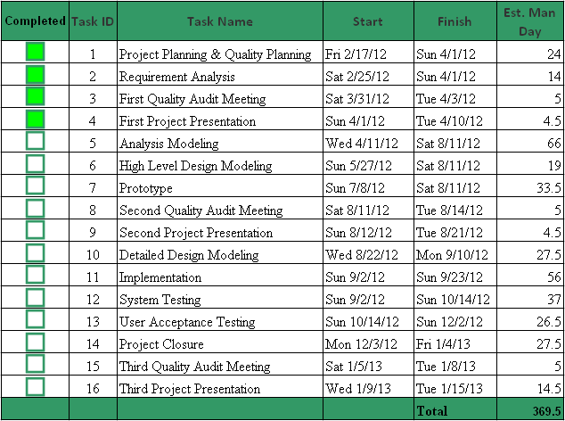
Project Timeline & Estimates

Slide 11
Project Progress

